Slide 1


Slide 2
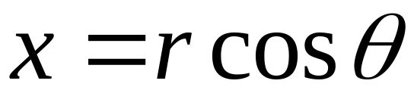
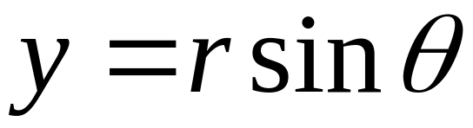

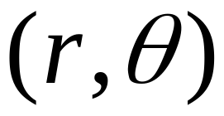

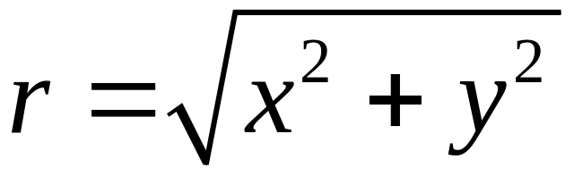


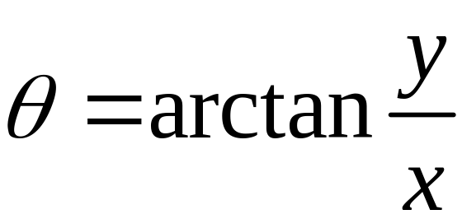


Slide 3
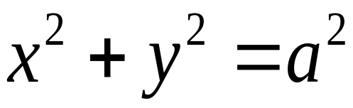
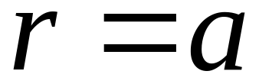

Rectangular coordinates
Polar coordinates
circle

Slide 4
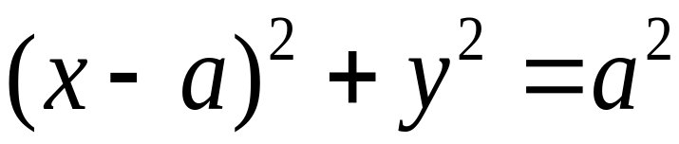
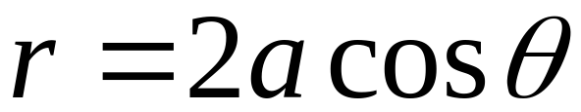
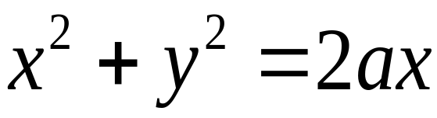
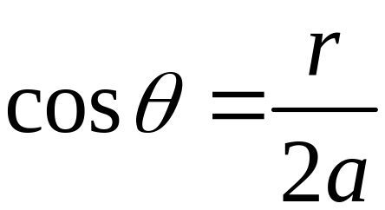

rectangle
polar
cirle
or

Slide 5
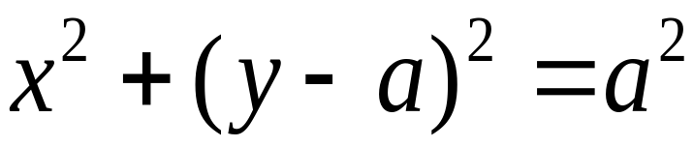
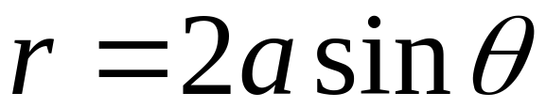
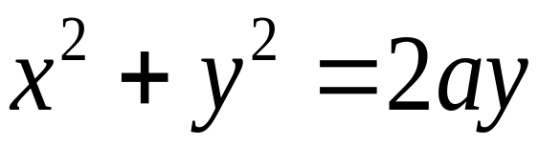
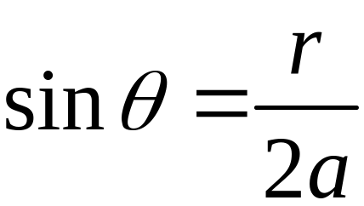
rectangle
polar
circle
or

Slide 6
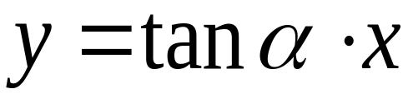
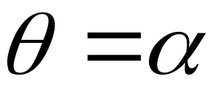

rectangle
polar
line

Slide 7

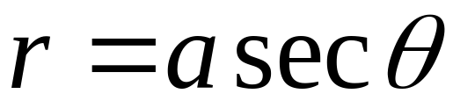
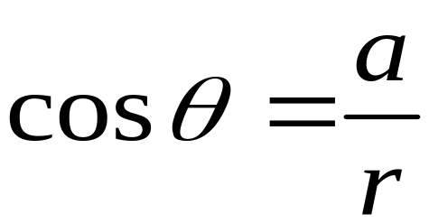
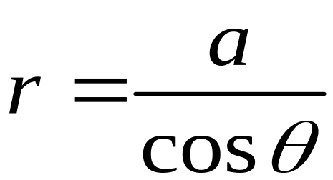
rectangle
polar
line
Not simple

Slide 8
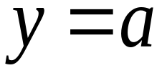
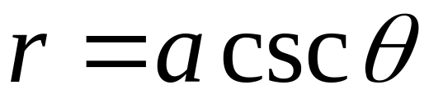
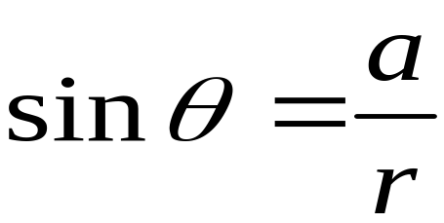
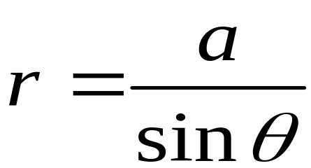
rectangle
polar
line
Not simple too

Slide 9
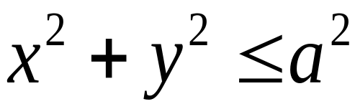
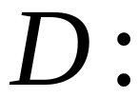
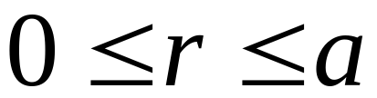
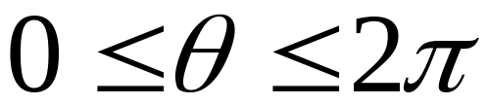

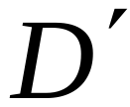

Rectangle
Polar
D：
Rectangle?

Slide 10




Area element in polar coordinates
If

Slide 11
A family of half lines
circles

Slide 12


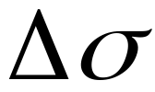





Slide 13
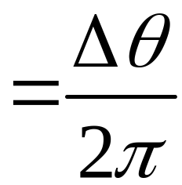
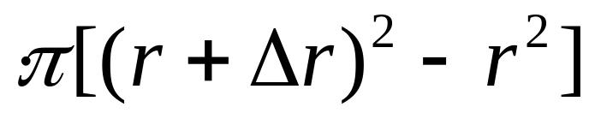
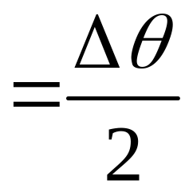
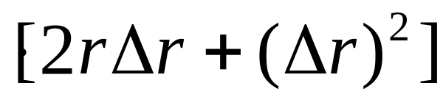
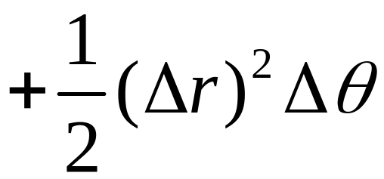




Slide 14
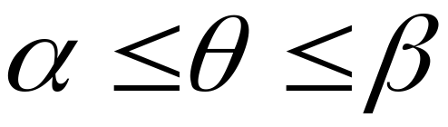


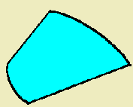
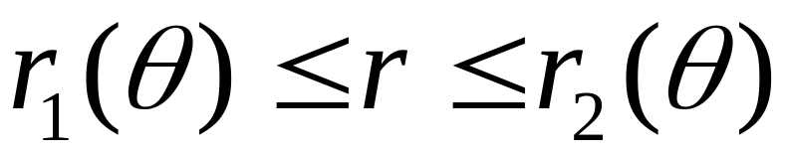



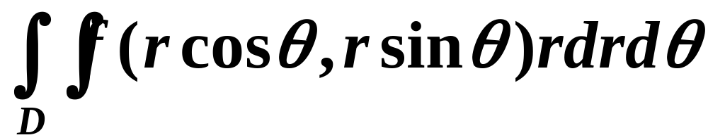


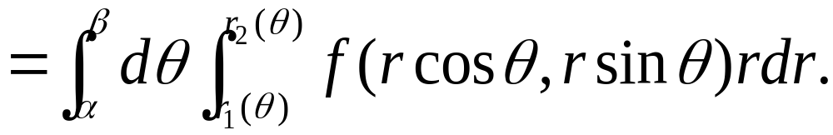
二重积分化为二次积分的公式
一般采用：先 r 后

Slide 15

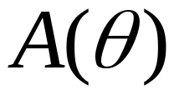

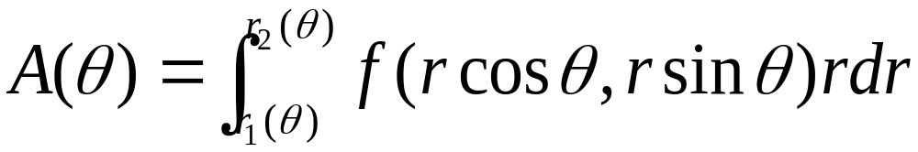

Slide 16


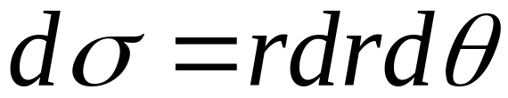
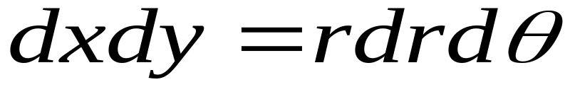
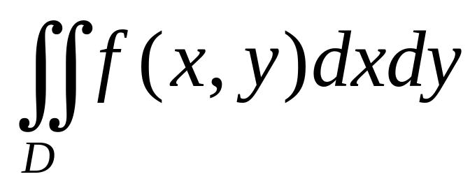
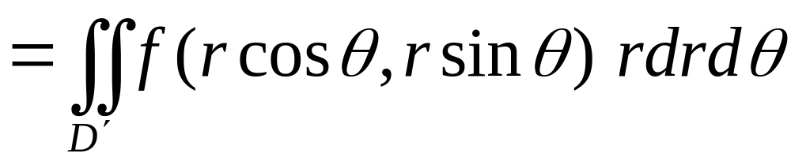
Area element in polar coordinates

Slide 17
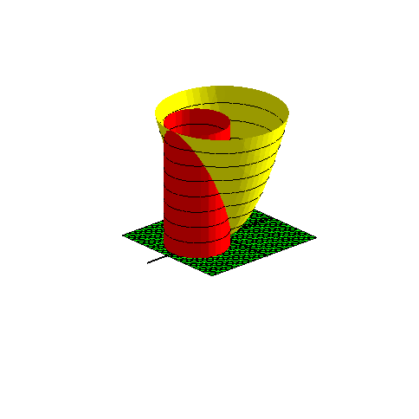
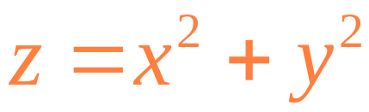
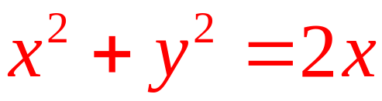

Example
Find the volume of the solid bounded by
and
and
with(plots):
qumian:=implicitplot3d(z=x^2+y^2,x=-2..2,y=-2..2,z=0..4,color=yellow,grid=[20,20,20]):
pingmian:=implicitplot3d(z=0,x=-2..2.2,y=-2..2,z=0..0.1,color=green,grid=[20,20,20]):
zhumian:=implicitplot3d(x^2+y^2=2*x,x=-2..2,y=-2..2,z=0..4,color=red,grid=[20,20,20]):
x_axis:=plot3d([u,0,0],u=-2..3,v=0..0.01,thickness=2):
y_axis:=plot3d([0,u,0],u=-2..2,v=0..0.01,thickness=2):
z_axis:=plot3d([0,0,u],u=-2..2,v=0..0.01,thickness=2):
display(qumian,pingmian,zhumian,x_axis,y_axis, z_axis,orientation=[48,66],scaling=constrained);

Slide 18
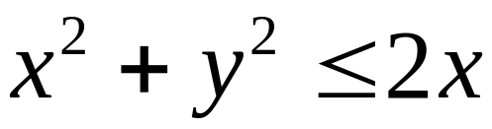





Projection onto z=0, D：
The surface of the “top” of the solid
So

Slide 19








Slide 20












Example
Solution
In polar

Slide 21







Notice that
What do you see?

Slide 22




由于
的原函数不是初等函数
不能用Newton-Leibniz计算定积分
下面借助二重积分来求

Slide 23











Slide 24





Slide 25





概率积分

Slide 26





Exercise
面密度：
求质量M＝？
在圆
以外
在圆
以内
两圆交点：

Slide 27








Slide 28
END

